Slide 1
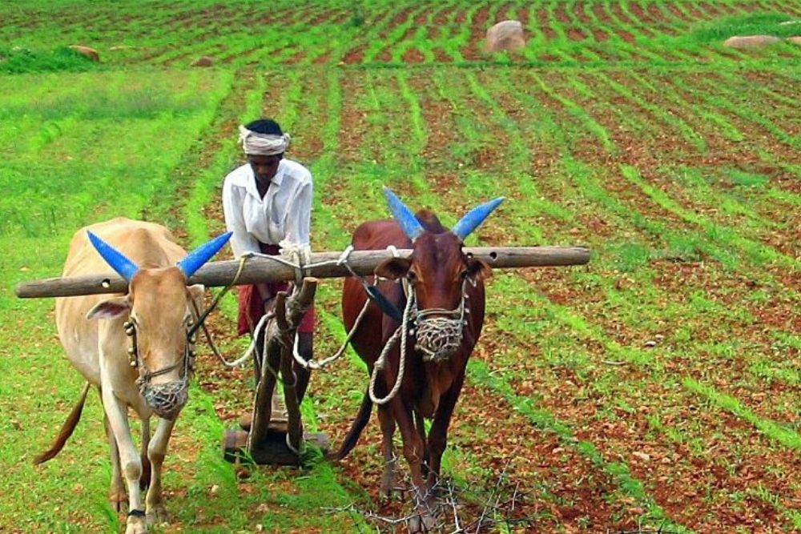
Improving
Agriculture Sustainability
Submitted by:
Jashandeep Kaur

Slide 2

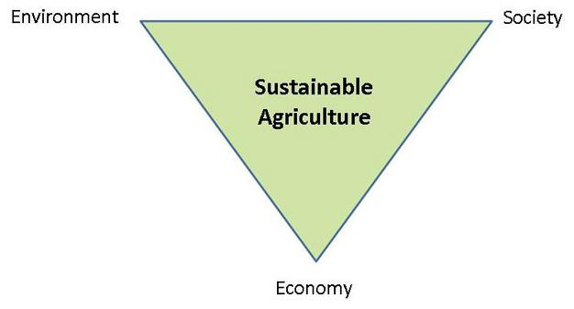
Context
The basic goals of sustainable agriculture are environmental health, economic profitability, and social and economic equity (sometimes referred to as the “three legs” of the sustainability stool)
Sustainable agricultural practices are intended to expand the Earth’s natural resource base and maintain and improve soil fertility. By adopting sustainable practices, farmers will reduce their reliance on nonrenewable energy, reduce chemical use and save scarce resources.
We are providing solutions in this project which will help a Iot in achieving agriculture sustainability

Slide 3

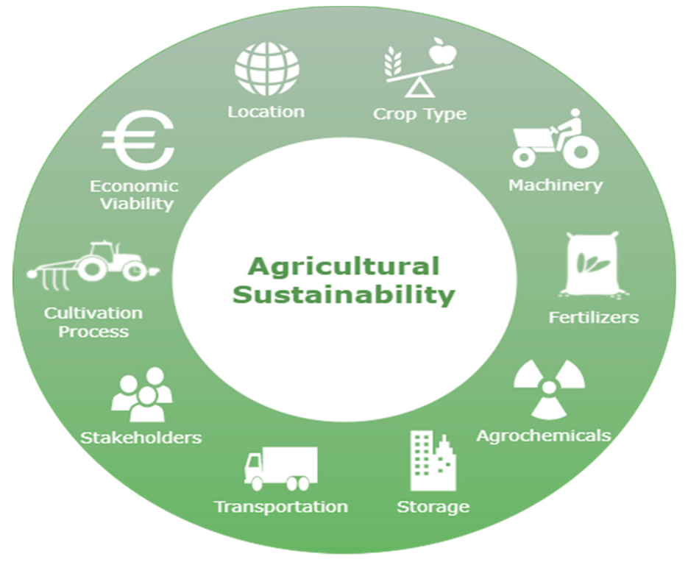
Business Relevance
As 20% of whole GDP is contributed by agriculture in India. This is the most important business sector in the country. Agriculture is the backbone of every economy. The success of any country's economy depends on the agricultural sector, which makes up just over 80% of all the labor force employed in the world.
Smart agriculture refers to the use of advanced technologies and data analytics in farming practices to increase productivity, reduce the production cost and improve sustainability.
The business relevance of smart agriculture is significant and offers various benefits for farmers, agribusinesses, and the agricultural industry as a whole:-
Increased productivity
Resource optimization
Cost savings
Enhanced decision-making
Traceability and quality assurance

Slide 4

Business Solution
PROBLEM 1
Farmers face a major challenge in context of selecting best crops to sow for their fields according to their various land conditions.
Solution -Here 'Crop Recommendation system ' detect various conditions like moisture, temperature, humidity etc and provide a list of options of crops that can be sown in particular field.
PROBLEM 2
Excessive use of chemicals and pesticides also pose a major problem as it can damage the crops and can diminish nutrients inside.
Solution - 'Fertilizer Recommendation System' acts as a solution as it suggest the best fertilizer required for the crop according to its requirements such that it increases the crop yield.
PROBLEM 3
Different crops require different levels of irrigation and mostly farmers fail to understand the exact need of irrigation for their crops effecting the crop production.
Solution –’Irrigation Scheduling’ can help by detecting the moisture already present in the soil and weather conditions which predict amount of rainfall crop may receive. Thus, it can accordingly suggest the best practices for the irrigation.

Slide 5

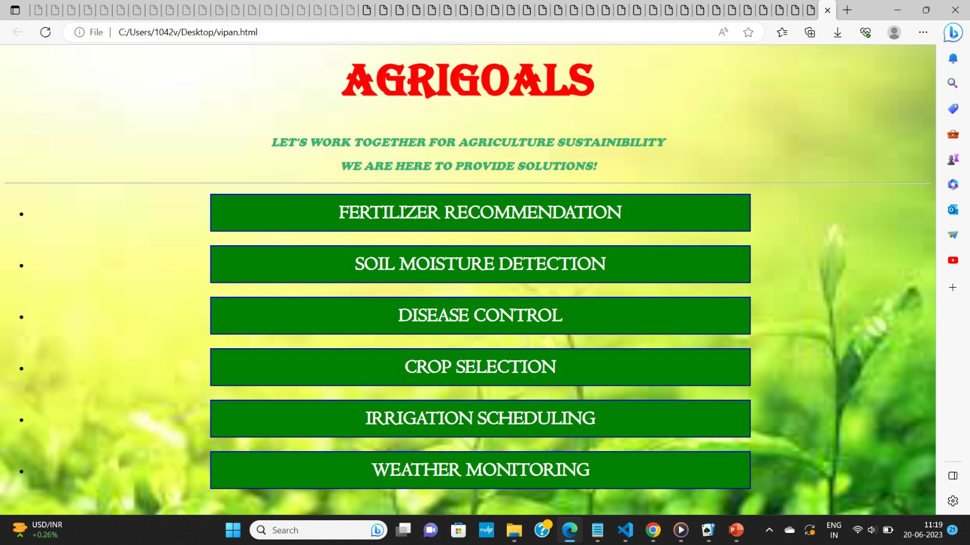
Design

Slide 6

Overview of Design
AGRIGOALS is the solution which aims at aiding in agriculture sustainability. Here there are different use cases which provides solutions for various hurdles faced during farming. Various buttons direct us to different pages where by filling the data detected with the help of sensors. It provide us with the various apt solutions. Similarly , different use cases were employed to provide different solutions for different problems to provide various benefits to farmers.
For eg-~ 'SOIL MOISTURE DETECTION ' uses different variables like temperature, pressure, humidity ,pm etc to inform the farmers about the moisture of the soil.

Slide 7

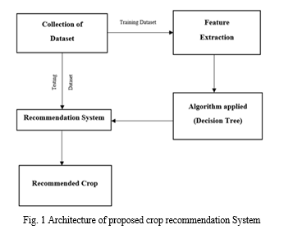
Architecture
This project is based on idea of 'MACHINE LEARNING'. Different sensors can be deployed at various locations in the fields to collect variety of data .This data is then used by various ML models to make various predictions and provide different solutions.
For eg - 'Crop Recommendation System' used different variables like [Nitrogen,Phosphorous, Temperature, Humidity, Ph value , Rainfall levels].Then, feature extraction can be applied on it to select the useful variables for our dataset .This data is cleaned, analysed, visualized and then divided into training(80%) and testing dataset (20%). Then, various ML models like Logistic Regression, Decision Tree, XG Boost, SVM are applied to find the best model for our solution which provides the maximum accuracy. On finding the best model - Decision tree ,it is deployed in solution to provide output on the basis of various input variables provided.

Slide 8
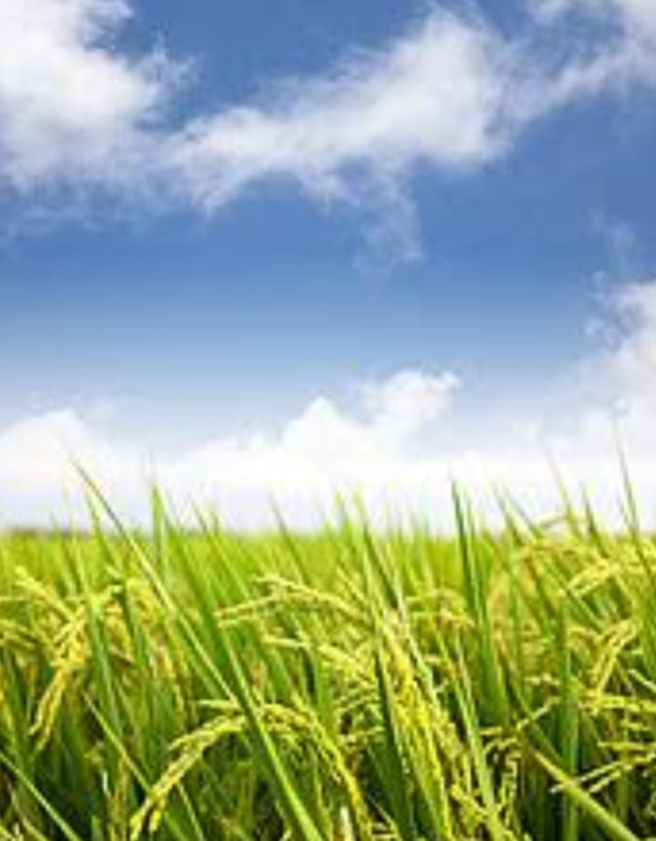

Flow Diagram
DATA FROM DEVICE
DATA CLEANING
ML MODELS
PREDICTIONS
DEVICE
(Eg: Soil moisture detecting sensors)
ACTUATORS
(Eg: Irrigation Pumps)

Slide 9

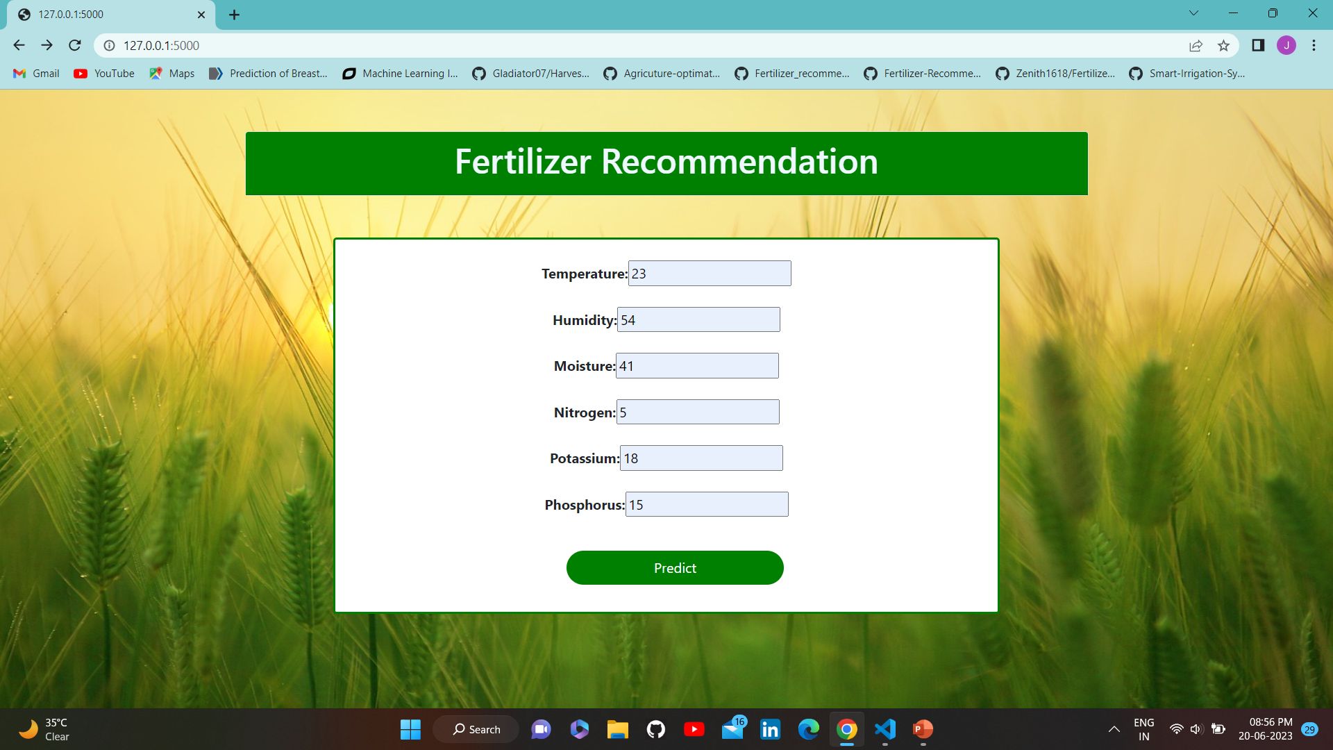
Deployment
With the help of flask, Ml model is deployed to an HTML page where we need to fill in certain values that are detected by sensors. Then after clicking on predict button ,it directs us to another web page which gives us the solution i.e determine the Fertilizer needed by our crop in the given example on right side.
Similarly we have made these html webpages for different sub-usecases which provides us the desired prediction for example- Crop selection, Soil Mositure Detection, Weather Prediction and Irrigation Scheduling.

Slide 10
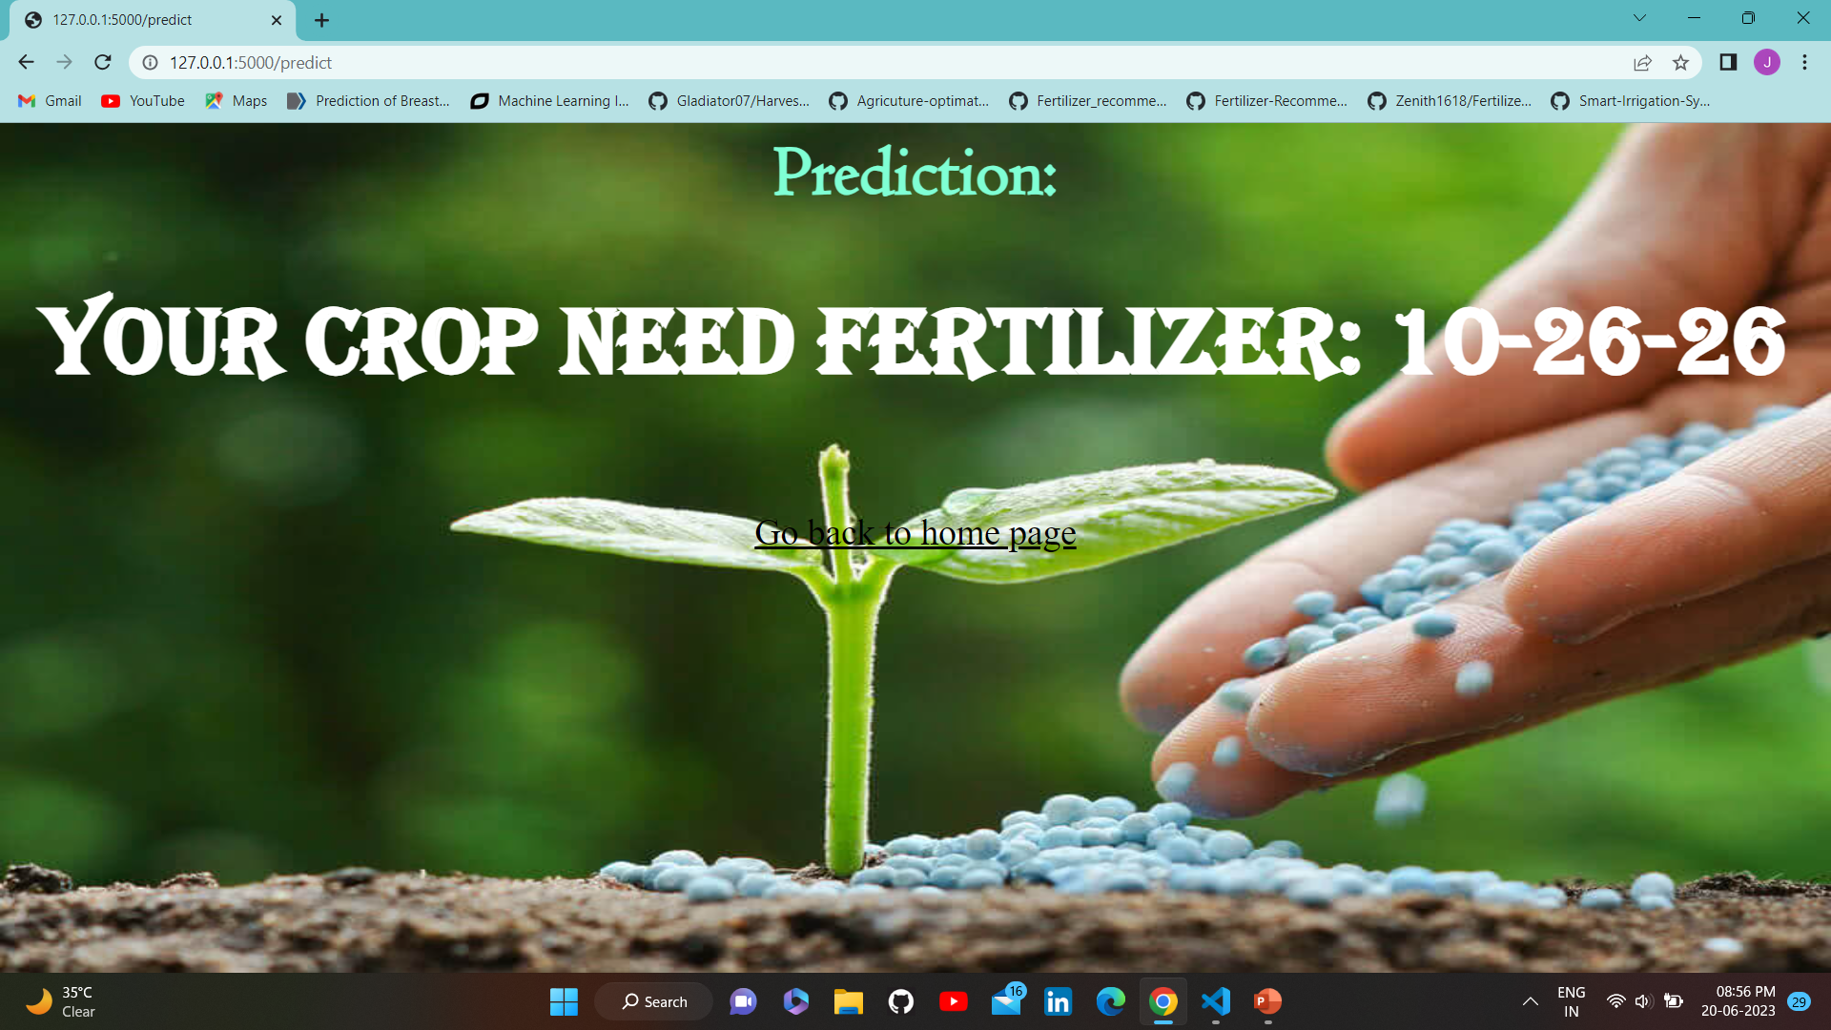
Results of Fertilizer Recommendation

Slide 11
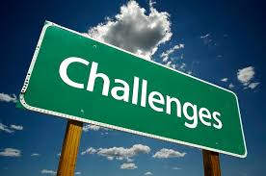
Arrival of Solution
Although there were some challenges faced during the development of project ,like to extract useful variables ,finding the right model ,proper deployment of sensors to extract useful features and final deployment to make predictions but these problems were solved with careful and proper implementation and working on the project.

Slide 12

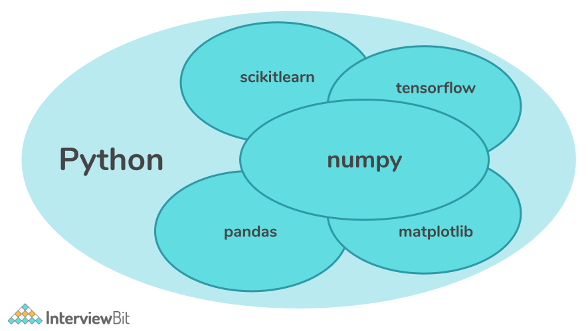
Technology Stack
PYTHON : It is a powerful language which integrated well with any other software and it's simple algorithm makes it good choice for coding algorithms.
MACHINE LEARNING : It uses various libraries-
Numpy
Pandas
Matplotlib
Scikit learn
SCIKIT LEARN : It is an open source data analysis library .It provides various algorithms-
1- Classification (Identifying and categorizing data into groups ) * Logistic regression
2- Regression ( Used for continuous output) * Linear regression 3- Clustering (Grouping of similar data into groups) * K means

Slide 13


